Slide 1

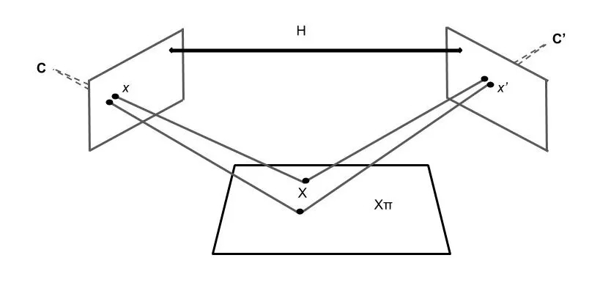
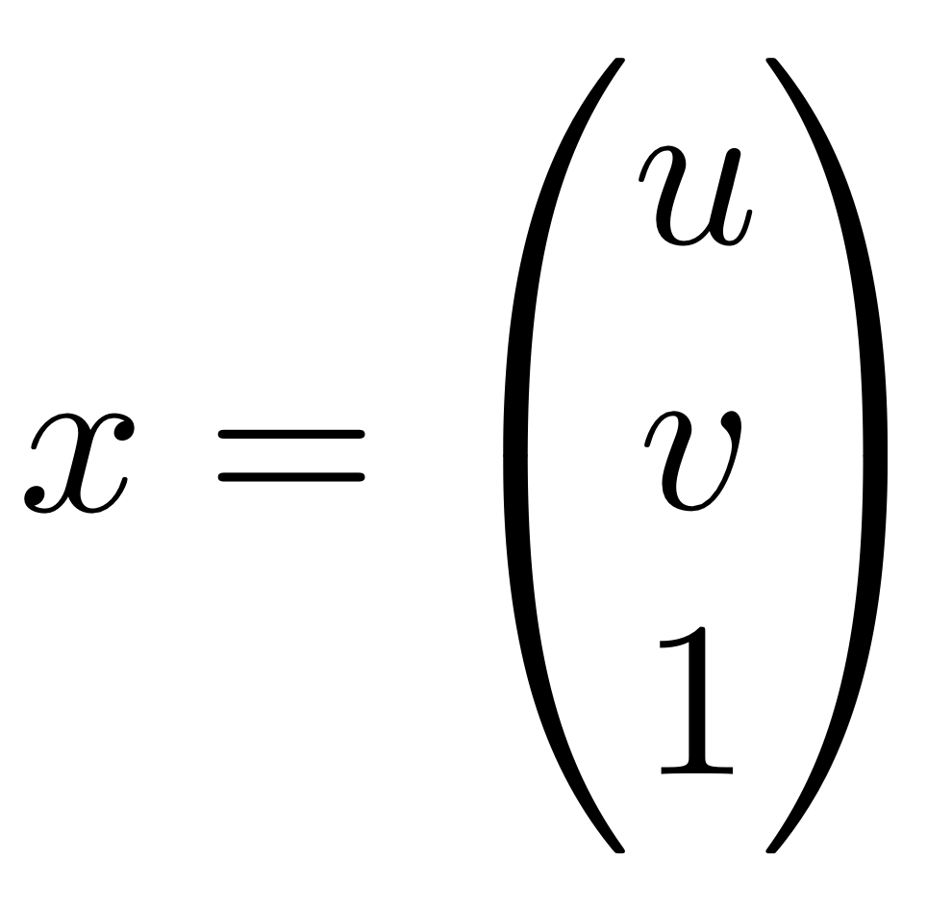
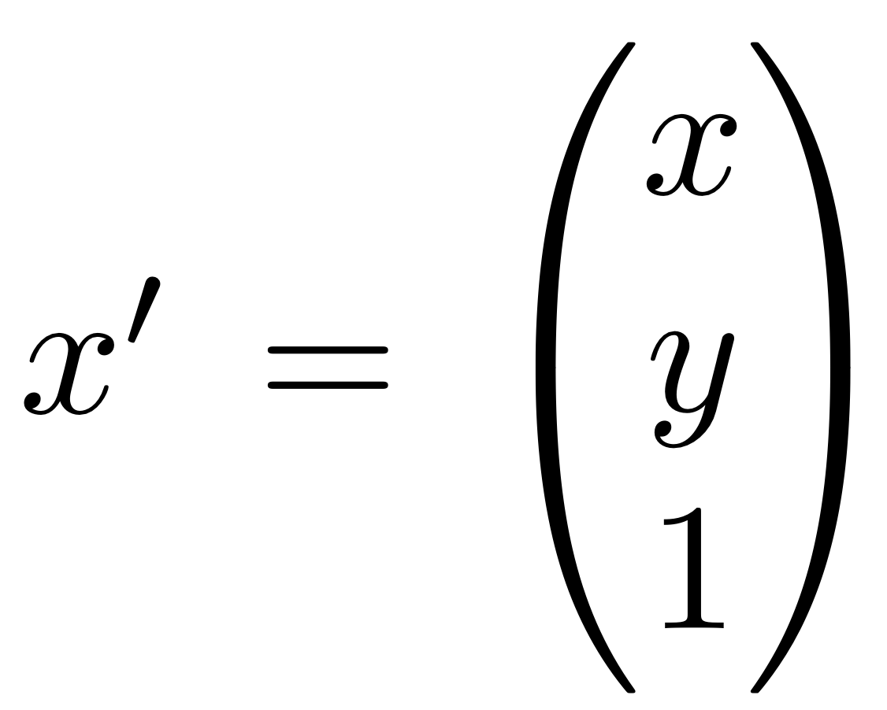
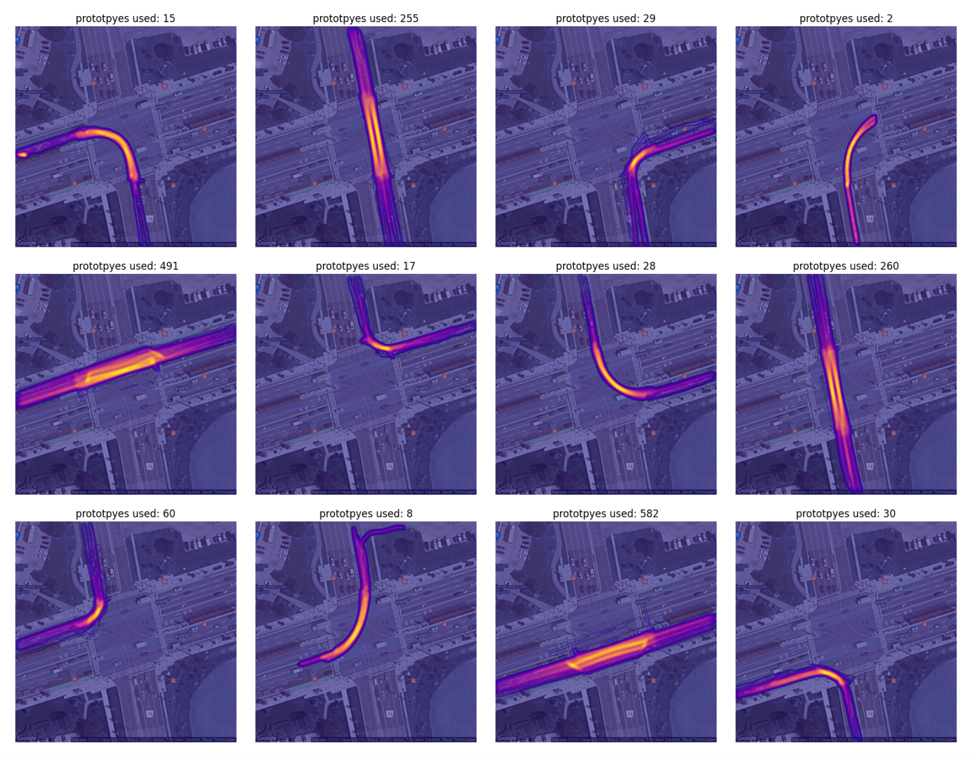
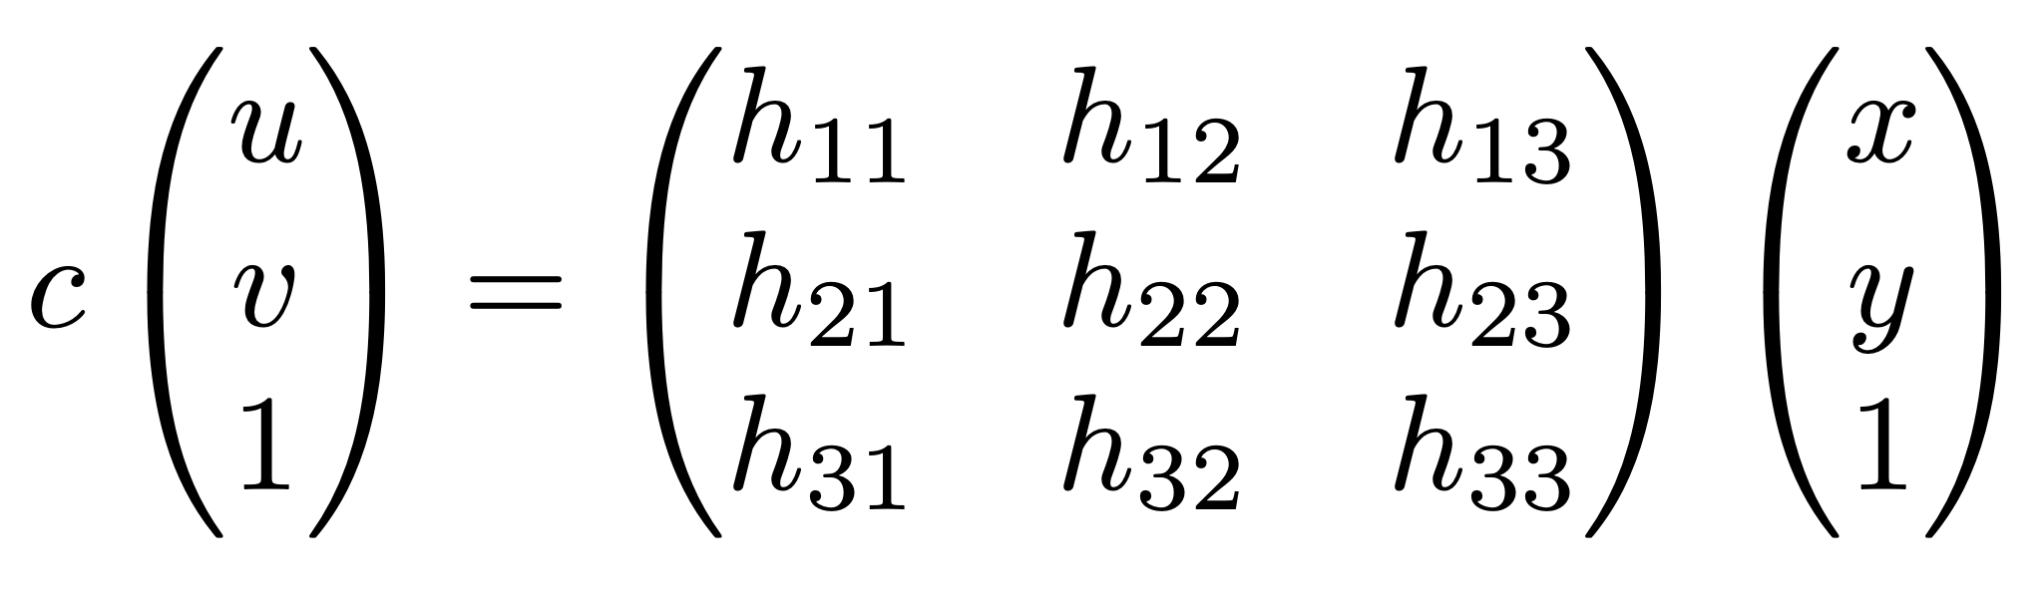
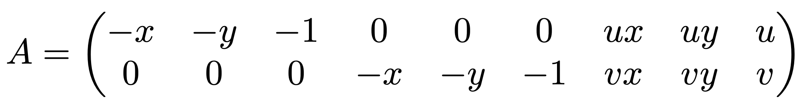
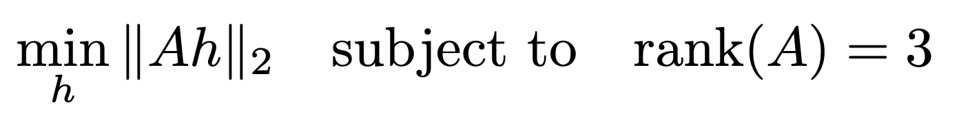
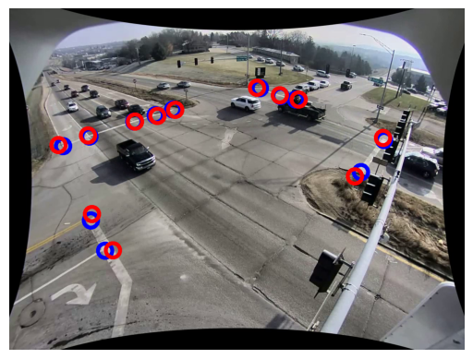
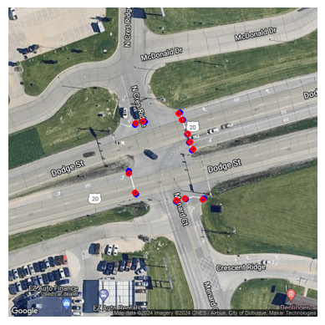
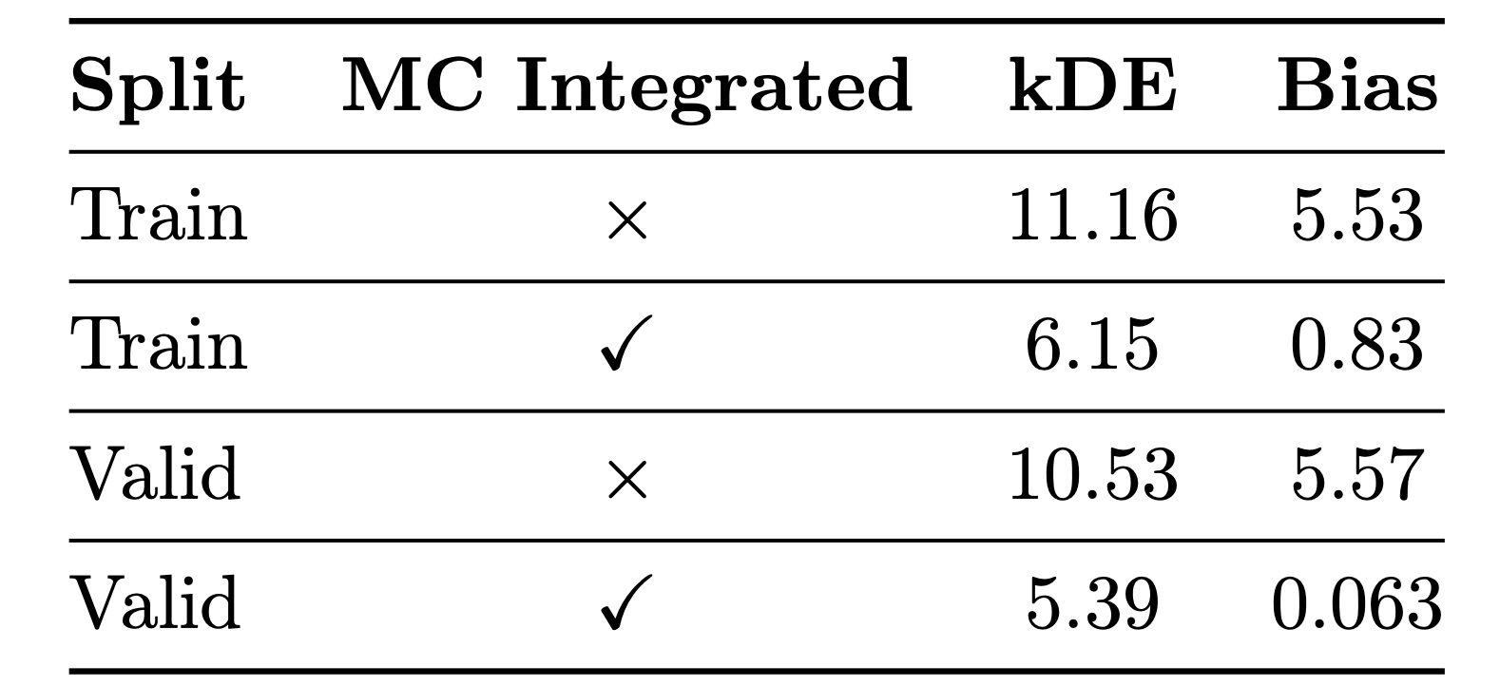
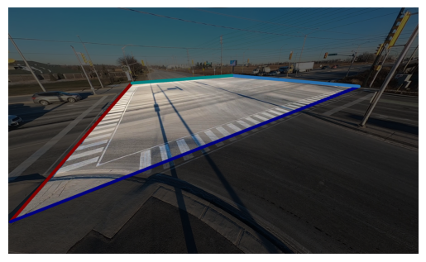
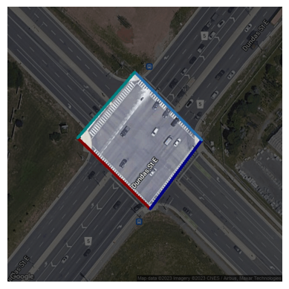
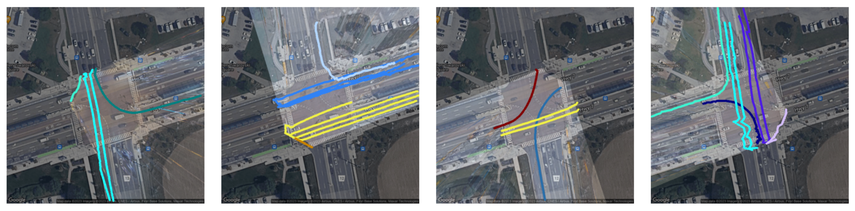
3D Multi-Camera Reasoning for Movement Turn Counts at Intersections
Sajjad Pakdamansavoji, Kumar Vaibhav Jha, James H. Elder
▻ Abstract
▻ 2D to 3D Transition
▻ Turn Counts
This poster tackles Movement Turn Count (MTC) through the lens of 3D reasoning, illustrating its accuracy and robustness in applications like surveillance and urban planning. By merging 3D tracking with geo-spatial elements integration, it improves MTC classification and its scalability and practicality across varied sensory environments, highlighting a significant leap forward in real-world applicability.
The transition is based on projective geometry and the fact that road users are approximately on a 2D plane.
Given prototypes of each movement, kernel density estimation is used to estimate probability distributions used for the generative Bayesian classifier.
▻ Methodology
Our MTC method follows a pipeline consisting of six main blocks: preprocessing, detection and tracking, reprojection to 3D, and counting.
Preprocess
To solve the optimization, we take a LMS approach requiring selection of pair points.
Heatmap of estimated densities for each movement
InternImage XL Cascade is used to perform detections
▻ Results
Annotate Intersection
Object Detection
Solve Homography
Object Tracking
Byte Track
Is used for multiple object tracking
2D to 3D
Prototype Extraction
Counting
Selected pair points and their back-projections
Classification percent error on Region of York Dataset.
▻ Multi-camera Prototypes
▻ Conclusion
Firstly one needs to select the intersection boundary.
To extract prototypes, we use all cameras and merge tracks on the reference 3D coordinates.
Utilizing 3D reasoning enhances distance measurement accuracy and facilitates the integration of multi-sensory data through conversion into a standardized real-world 3D coordinate system.
▻ References
K. Bhargava, S. Pakdamansavoji, B. Abdulhai, J. H. Elder, and S. L. Waslander, "Intersection traffic dataset," in Proc. IEEE/CVF Conf. Comput. Vis. Pattern Recognit. (CVPR), 2024.
a) Camera view
b) Aerial view
Selected prototypes from each camera view.

